Slide 1

SkyHigh Airlines
An Airline Management System

Slide 2





Team Members
Seaum Insaniat
Swapnil
2021-2-60-016
Shanta Islam 2022-1-60-288
Jerin Anan Proma 2022-1-60-132
Nusrat Jahan Oishi 2022-2-60-033

Slide 3

Submitted to
Yasin Sazid
Lecturer
Department of Computer Science & Engineering
EAST WEST UNIVERSITY
Course title : Software engineering
Course code : CSE 412
SECTION : 02

Slide 4
table of contents
01
02
03
04
05
06
07
08
09
10
11
12
Proposal
Project Overview
Vision &
mission
Requirement gathering
Relatable works
Why this project
platform
development
deployment
limitations
Database
design
Testing approach
Future work

Slide 5
Project Overview
admin
user
Manage booking
Manage hotels
Manage flights
Manage
users
View analytics
Book
hotels
faq
Flight
status
find
flights
Booking history

Slide 6
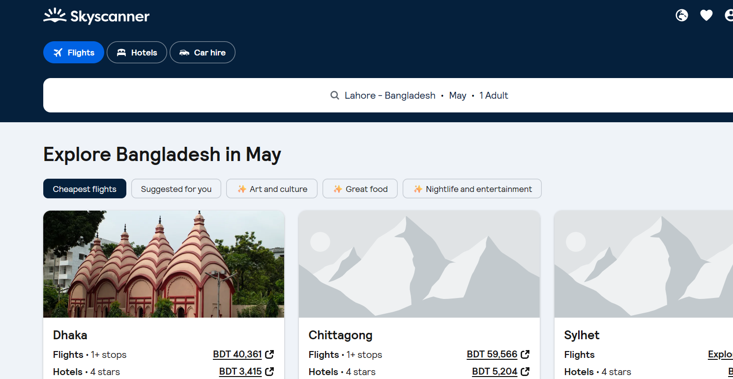
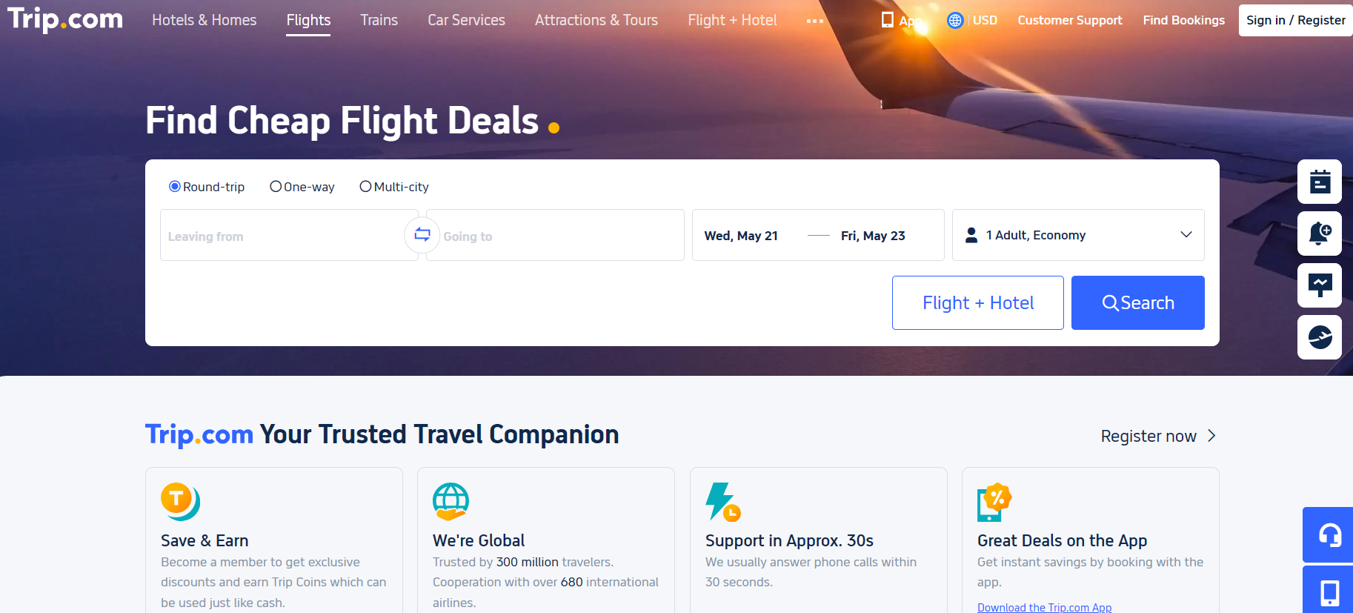
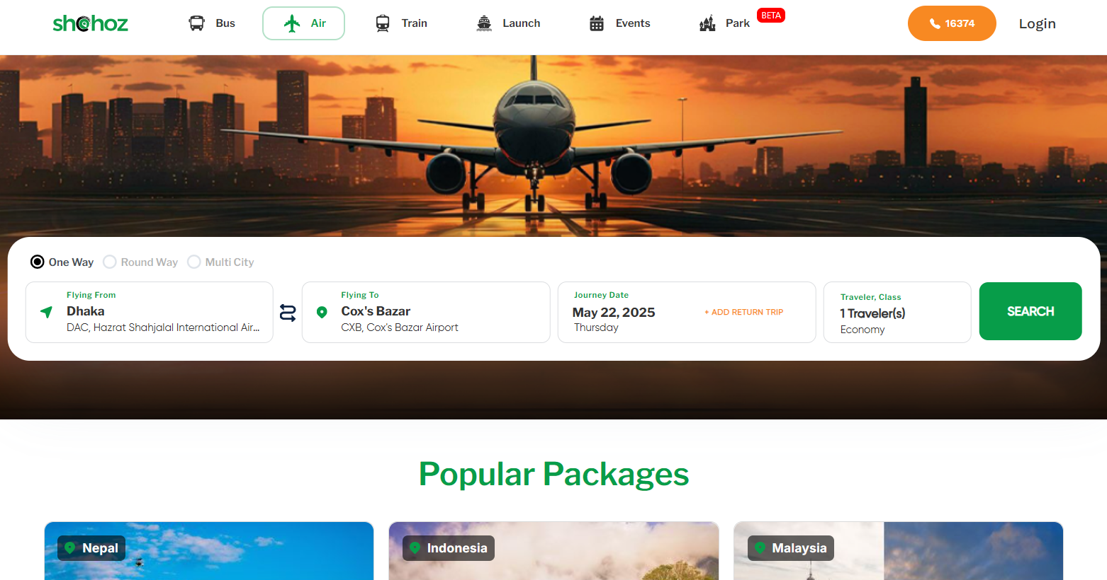
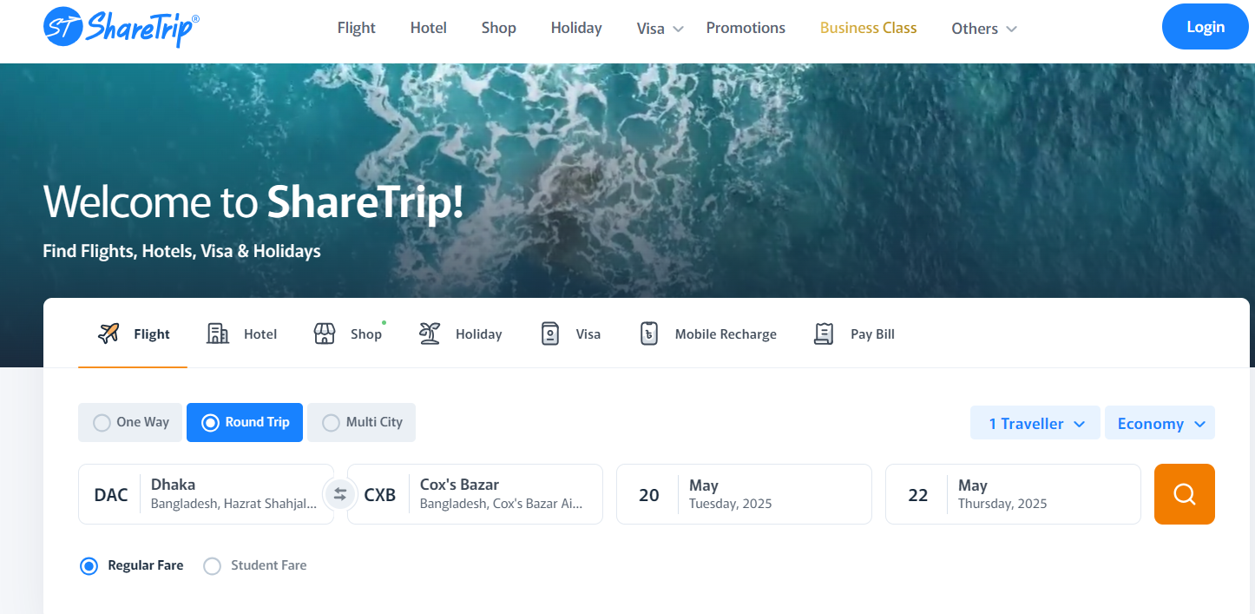

Different websites related to our Work

Slide 7
WHY
WE CHOSE IT?
Growing demand for efficient airline operations. Need for affordable, scalable solutions for small to medium airlines.
Provide a seamless booking experience for passengers. Enable efficient flight and passenger management for airline staff. Reduce operational costs through automation

Slide 8
vision
mission
To create a user-centric airline management system that simplifies travel planning and airline operations globally.
Deliver a reliable, scalable, and intuitive web-based platform.
Empower small to medium airlines with affordable technology.
Ensure high customer satisfaction through seamless user experience.

Slide 9

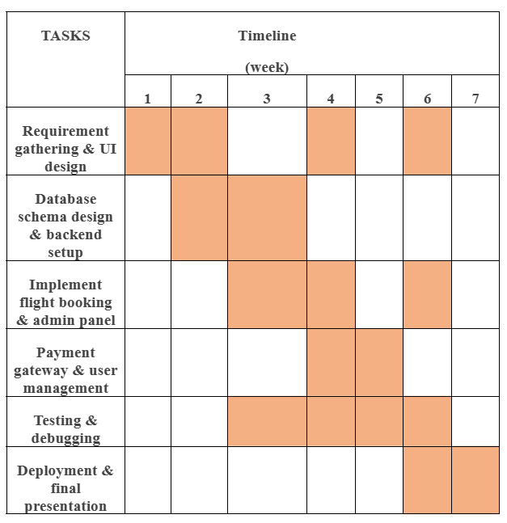
Proposal insights
Tentative Timeline
The project has followed the Agile Software Development Model, ensuring iterative and flexible development.
The timeline that was proposed for our project and applied to get the productive working outlines

Slide 10


Requirement gathering
Acceptable functionality
Finding similarities
Doing interviews
Implementation possibility
Final draft

Slide 11
Database design

Slide 12
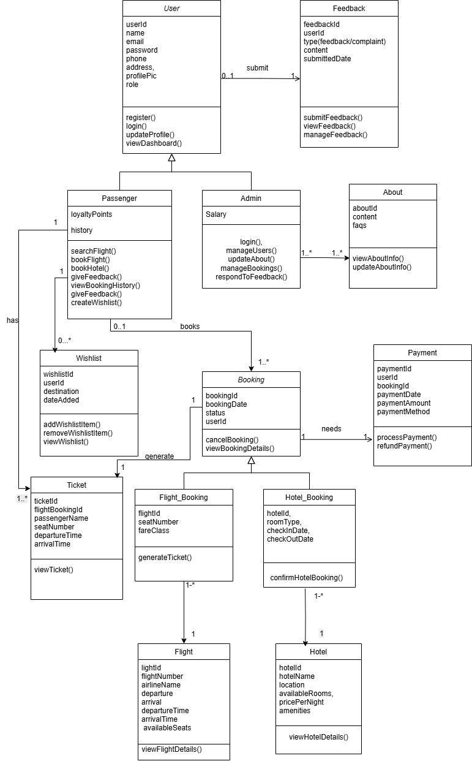
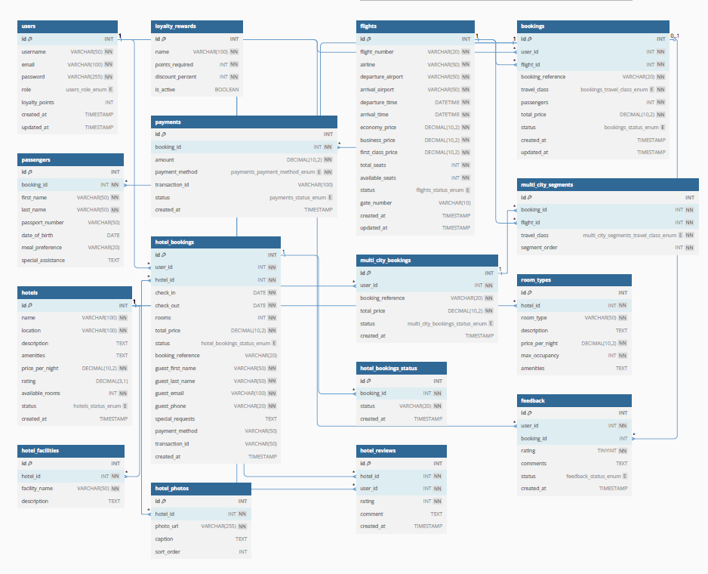

Slide 13
Technologies Used to Build the website
02
04
01
03
Frontend
Database
Backend
Other Tools
HTML, CSS, JavaScript
AJAX, jQuery, GitHub for version control, XAMPP for local testing
MySQL
PHP

Slide 14
Testing
approach
White box
Testing
Black box
Testing
Bug Detection

Slide 15
Deployment
Uploading Files
Domain Setup
03
01
05
04
02
File Transfer Setup
Web Hosting Platform Selection
Database Configuration
Testing Testing & Debugging

Slide 16
Platform dashboards

Slide 17

Website homepage

Slide 18
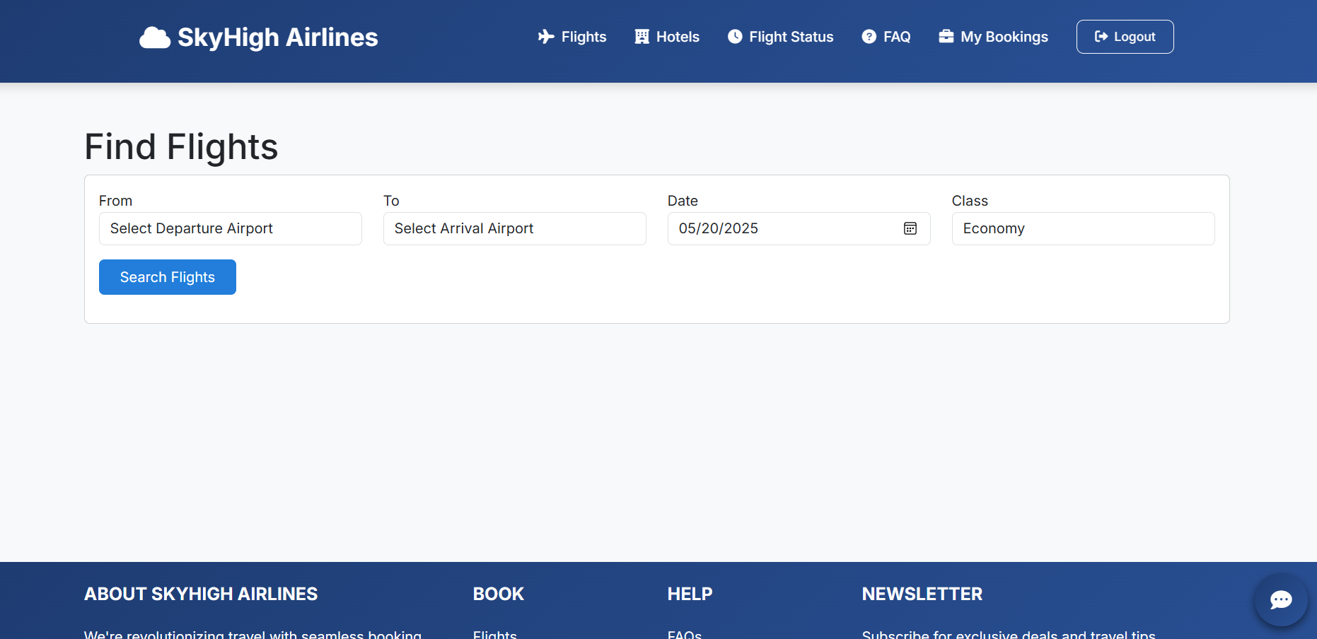
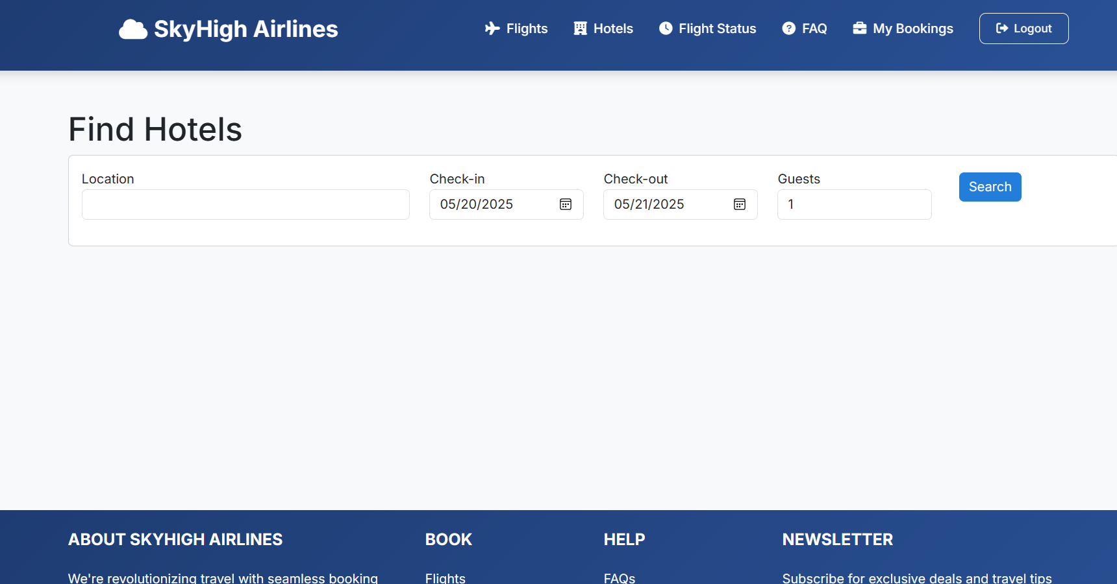
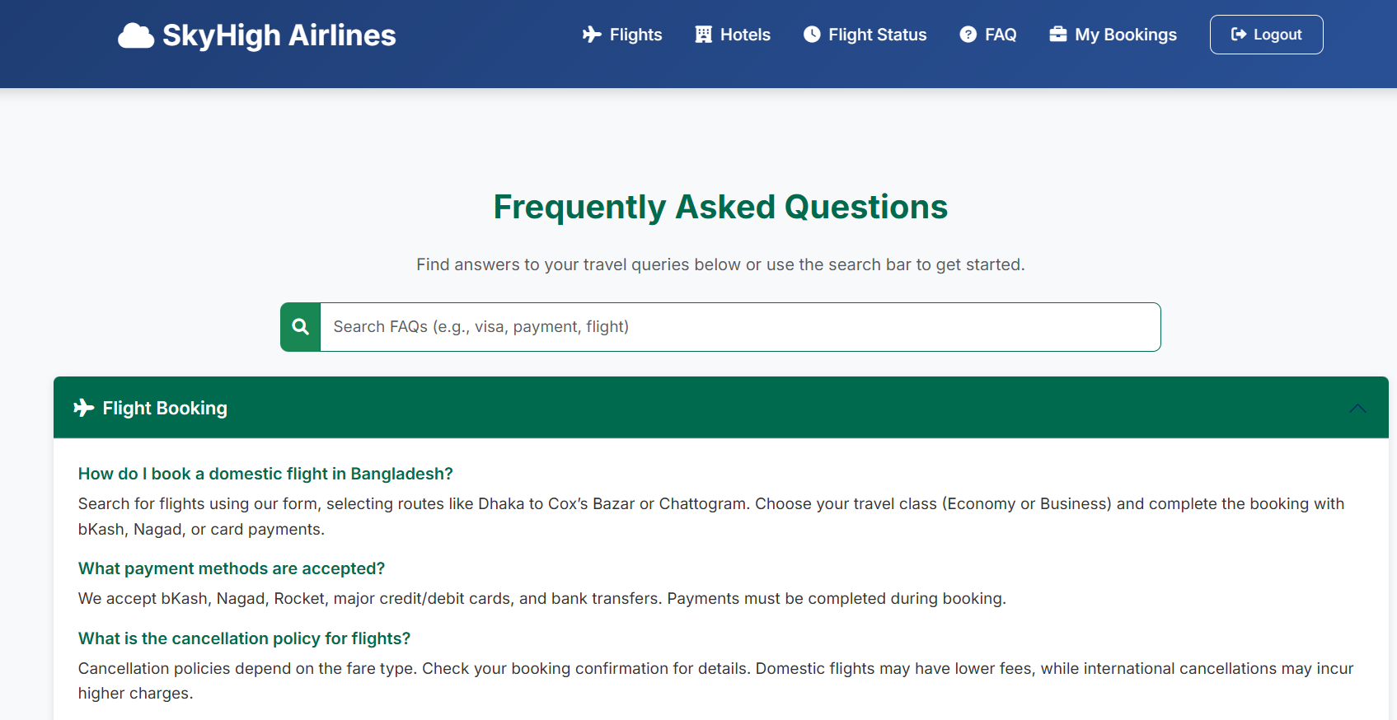
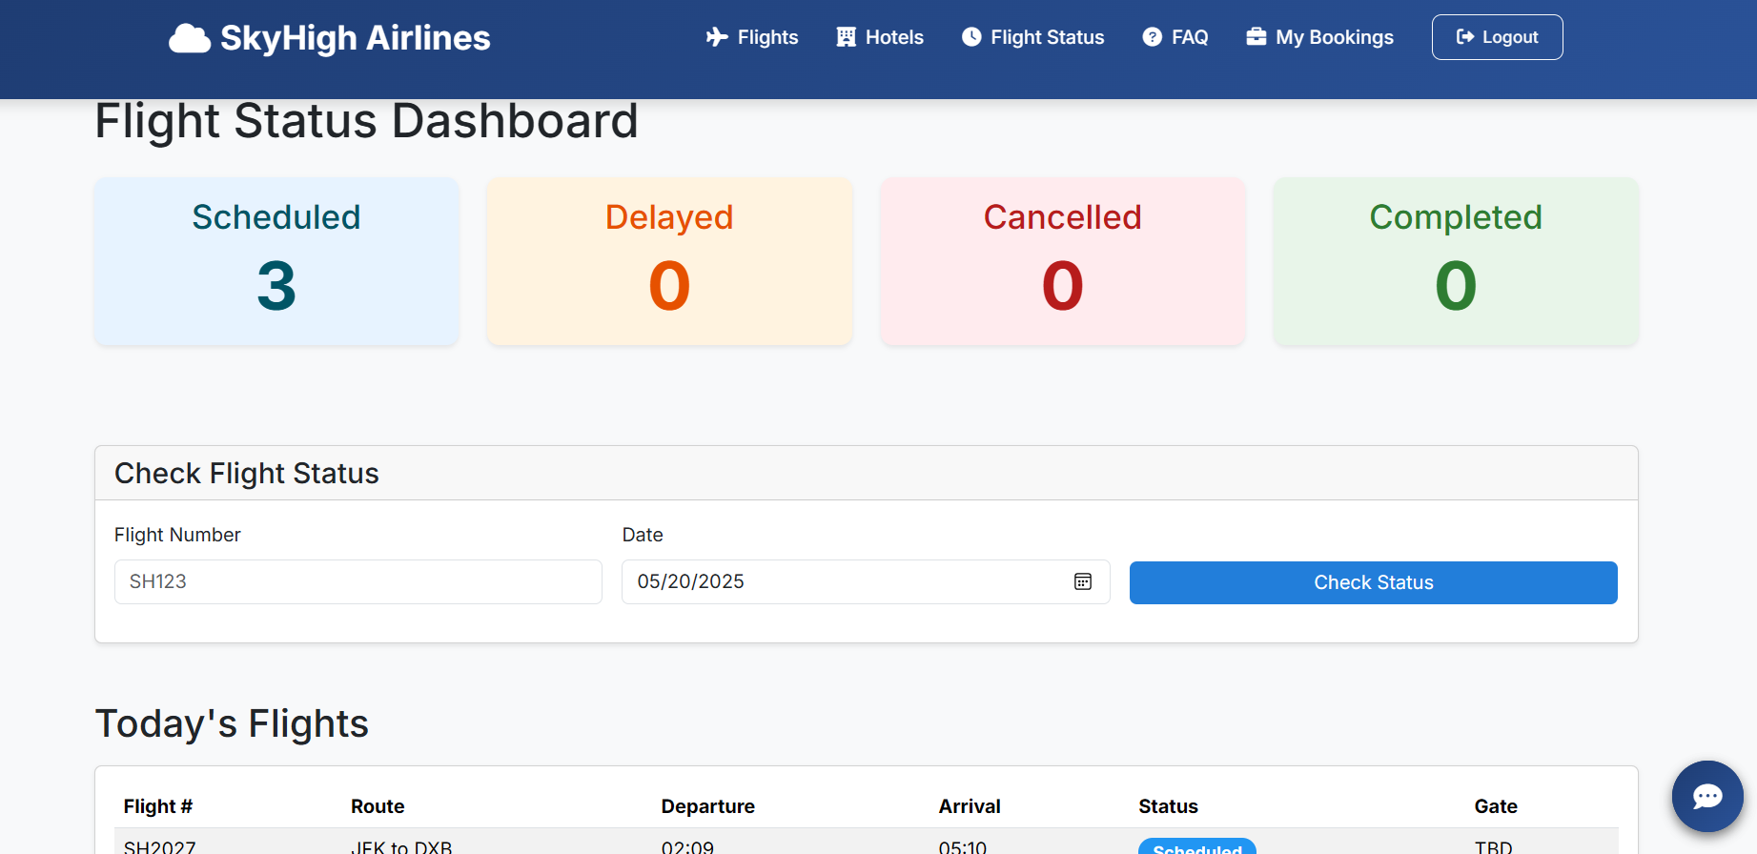
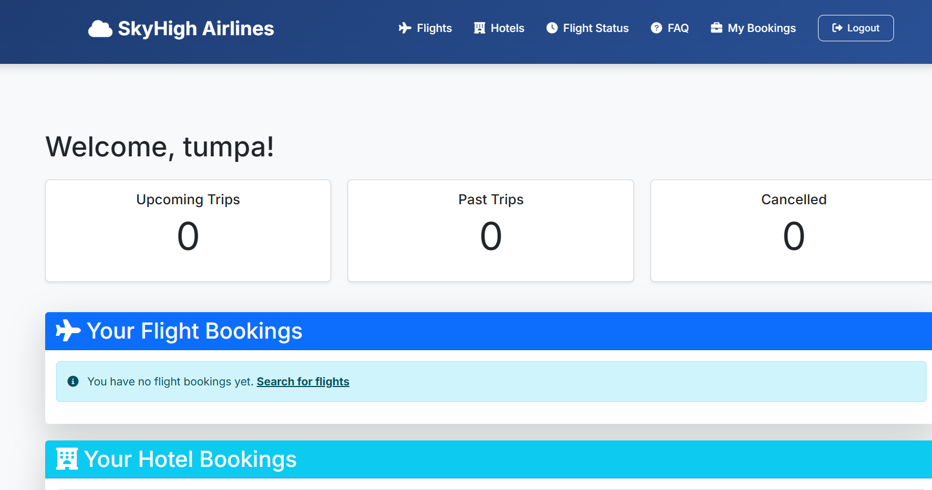
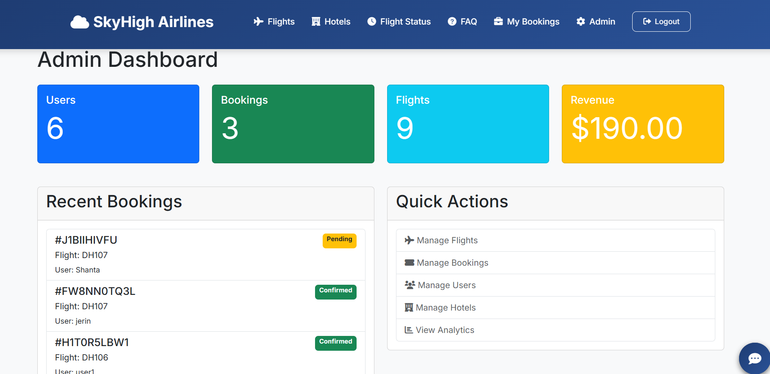
dashboards

Slide 19
limitations
01
03
04
02
Dummy chatbot
No mobile app, web-based only.
Basic analytics - advanced reporting features pending
Limited support for international flights and multi-airline integration

Slide 20




Future work
Apply ML Models for statistical analysis
Chatbot interaction
Best flight in range
Integrate with global distribution systems
Develop a mobile application for iOS and Android

Slide 21
Website Link
skyhigh.kesug.com

Slide 22
Thank You
Everyone
for
Your Attention!

